Slide 1
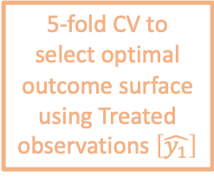
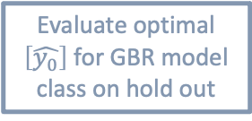
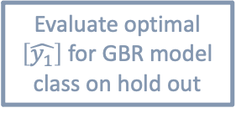
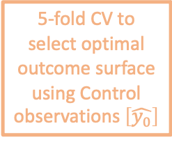
Pre-processing of the data
Model Selection
Model Evaluation
using 80% to train
using 20% hold out
5-fold CV to select optimal outcome surface using Treated observations $\left[\hat{y_{1}}\right]$
Use all variables available in HILDA (3,400 variables / observations)
Supervised machine learning for feature selection
Predict outcome in 2006
Select top 100 predictors
Evaluate optimal $\left[\hat{y_{1}}\right]$ for GBR model class on hold out
Repeat nested CV 10 times (10 outer folds): average performance for GBR
Average MSE across treated and control models
GBR
5-fold CV to select optimal outcome surface using Control observations $\left[\hat{y_{0}}\right]$
Evaluate optimal $\left[\hat{y_{0}}\right]$ for GBR model class on hold out
Nested CV for each model class
“ “
Ridge
“ “
Ridge
“ “
“ “
Ridge
“ “
Ridge
“ “
“ “
“ “
LASSO
“ “
LASSO
“ “
LASSO
“ “
“ “
LASSO

Slide 2

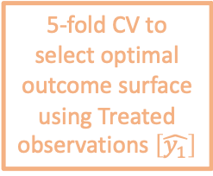
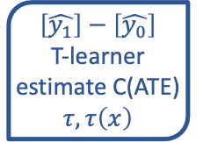


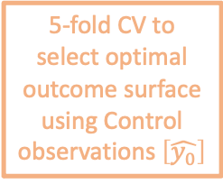
Pre-processing of the data
Uncertainty from hyperparameter selection ~ model configuration
Uncertainty from model parameters
5-fold CV to select optimal outcome surface using Treated observations $\left[\hat{y_{1}}\right]$
Estimate optimal $\left[\hat{y_{1}}\right]$ for GBR model class on full bootstrap sample [bs₁]
Use all variables available in HILDA (3,400 variables / observations)
Supervised machine learning for feature selection
Predict outcome in 2006
Select top 100 predictors
$$\left[\hat{y_{1}}\right]−\left[\hat{y_{0}}\right]$$
T-learner estimate C(ATE) $τ, τ\left(x\right)$
Repeat across 100 bootstrap samples for distribution over $τ, τ\left(x\right)$ for the GBR
GBR
5-fold CV to select optimal outcome surface using Control observations $\left[\hat{y_{0}}\right]$
Estimate optimal $\left[\hat{y_{0}}\right]$ for GBR model class on full bootstrap sample [bs₁]
Bootstrap a sample [bs₁] (sampling with replacement)
“ “
“ “
Ridge
“ “
Ridge
“ “
Ridge
“ “
“ “
Ridge
“ “
“ “
LASSO
“ “
LASSO
“ “
LASSO
“ “
“ “
LASSO

